Slide 1
Sprint 2 Demo
Helping Hand
Mental Health Awareness Application

Slide 2
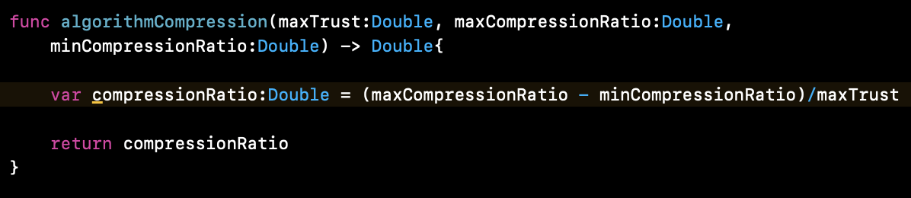
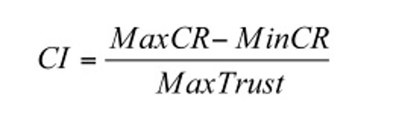
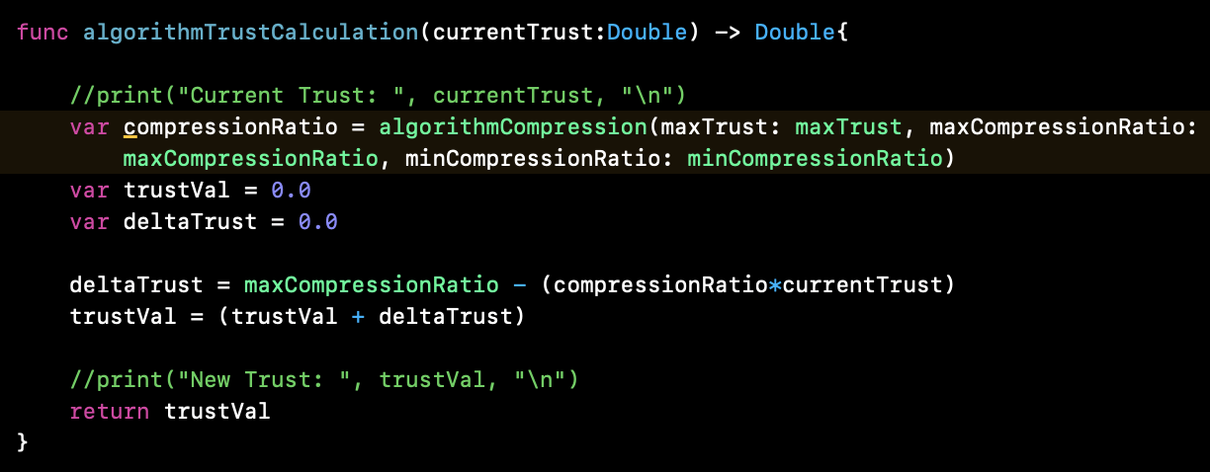
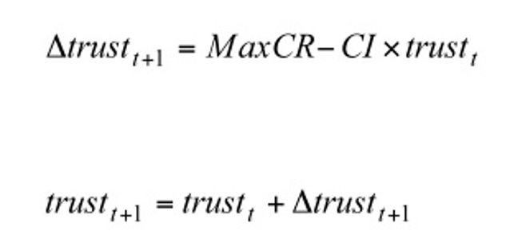
Algorithm Implementation
MaxCompression = 10
MinCompression = 0
MaxTrust = 100

Slide 3
Algorithm Implementation
Static
Multiple trust value by number of times a user interacted with a "Friends" post.
Dynamic
Run trust calculation every time an interaction occurs

Slide 4
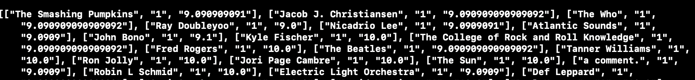
Algorith Result
Calculation of trust value
Sorted
Data is from Facebook Like/Reaction JSON file

Slide 5
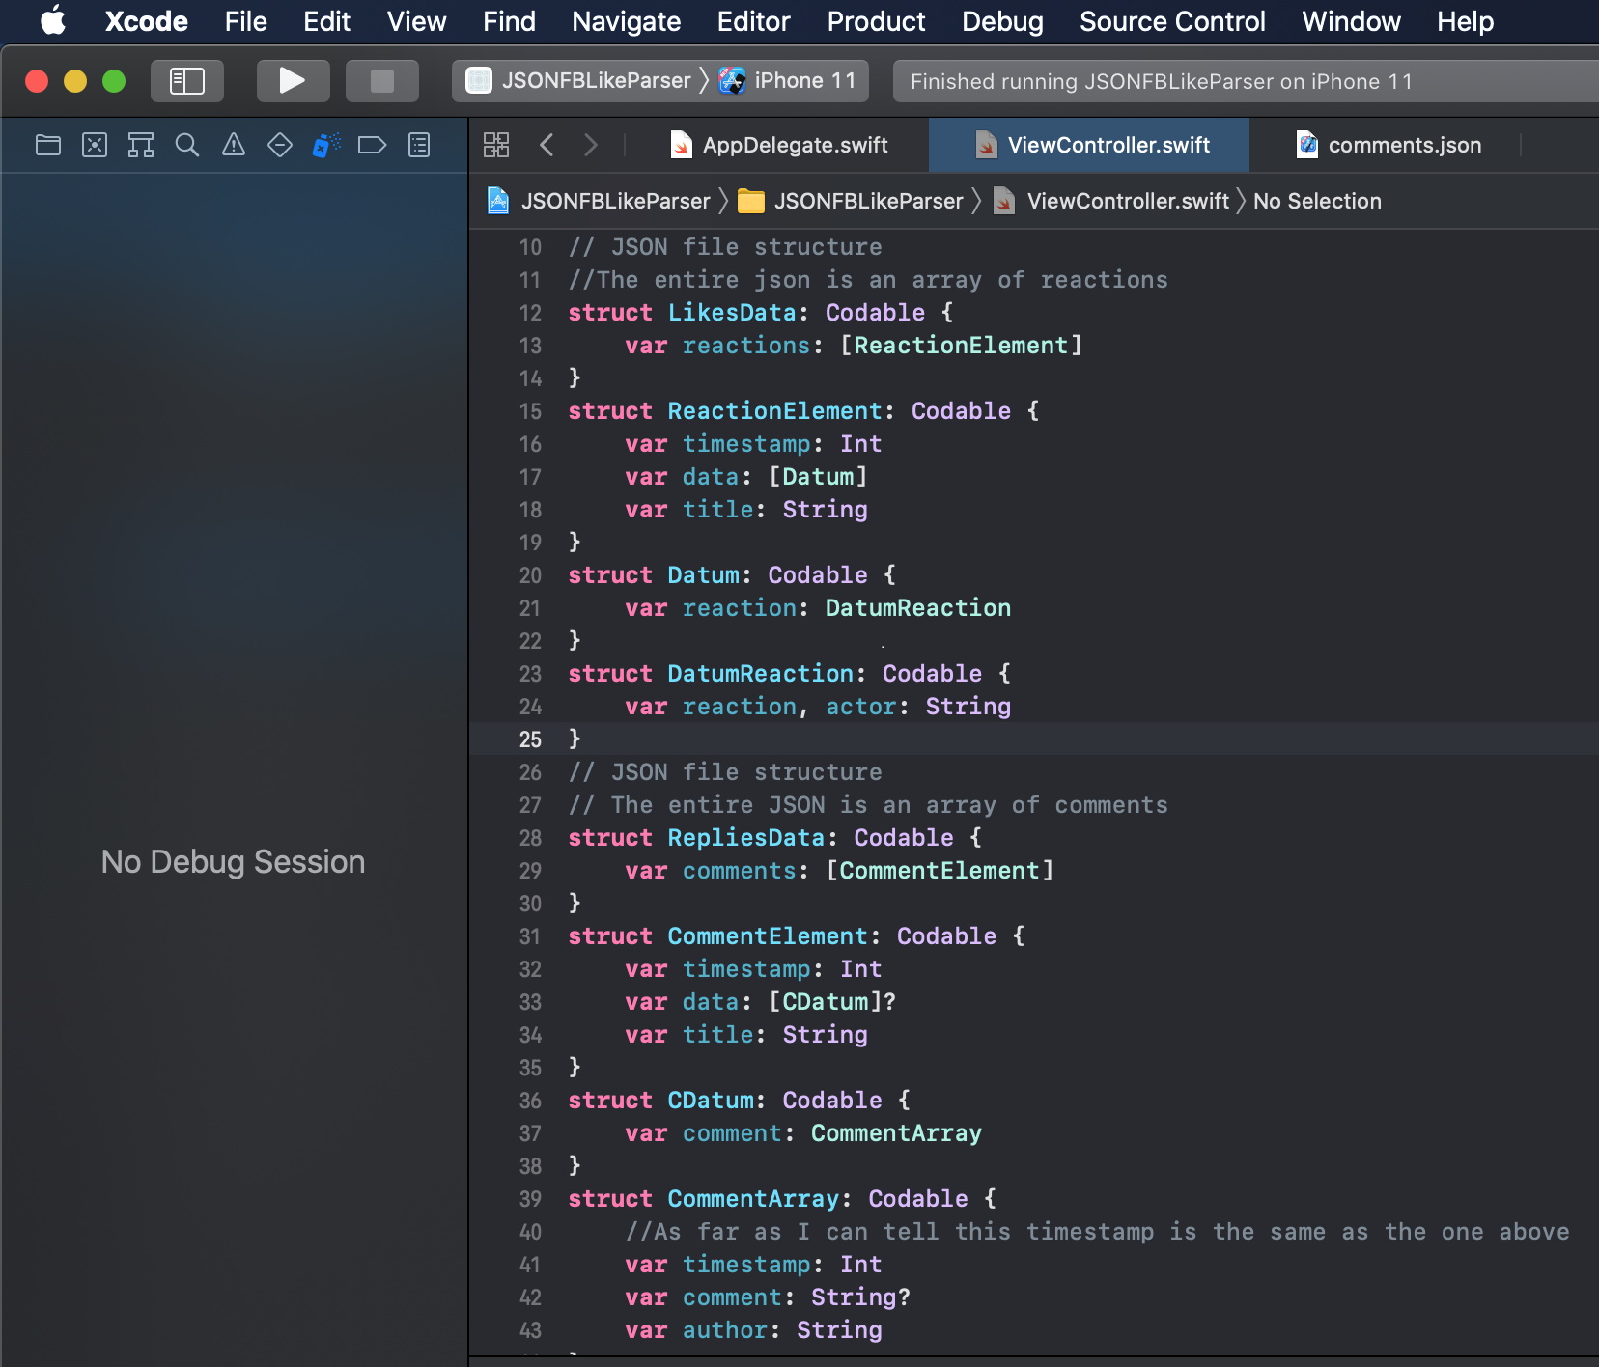
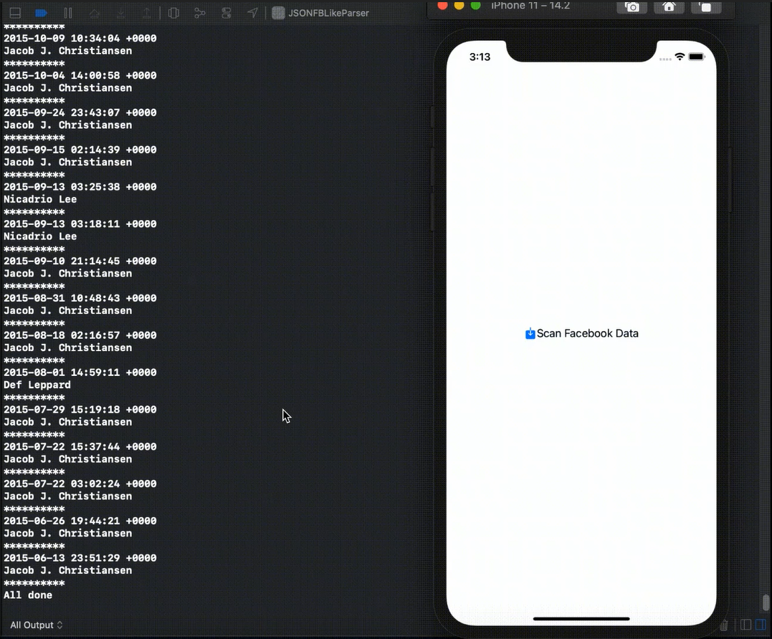
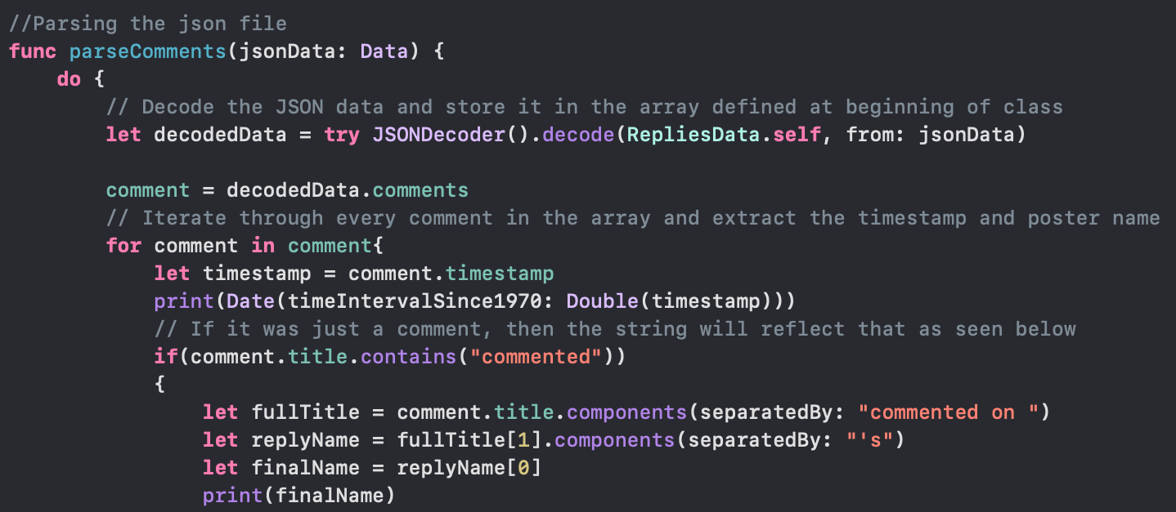
Facebook Data
User uploads specified JSON files
Uses Swift's Codeable structure for file structure
One set of code pulls reactions/likes to posts and comments
The other gathers comments/replies
Timestamps are collected for both sets of data, along with the name of whose post/comment is being responded to
Code is setup to easily send data to the algorithm

Slide 6
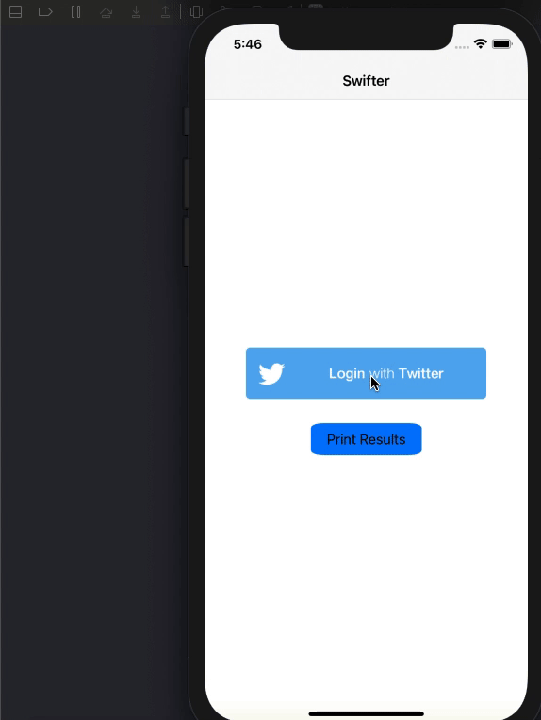
Swifter – Twitter API
End of last sprint: Modified demo of swifter to print out raw JSON format of messages.
Favorites:
Pulls JSON for the most recent favorited tweets by the user
Parses out the original poster and timestamp(date)
Messages:
Pulls JSON for user's direct messages that occurred in the last 30 days (reverse chronological order)
Parses out the other user involved and the timestamp for each message
Timestamp is converted from Unix time to a date similar to messages
Stored in separate arrays for now, printed as shown in gif.
Removed unnecessary parts related to original demo.

Slide 7
UI
SeeCircleView
AccountLinkingView
UI Design for:
BlockView
Weights

Slide 8
Documents
Edited Test Plan to fit slightly adjusted goal for this semester
Main goal in documents to record progress and use as reference point for future decisions, see what has changed
Completed version 2 of :
SRS
SDS

Slide 9
Next Sprint Goals
Algorithm
Get more data filtered into Algorithm
Weight ratio can be factored in
Negative occurrences
Connect sorted contacts with UI
Add time component
UI
Connect the views to the algorithm and parsing parts
Data Handling
Add master contact list to connect contacts across platforms​
Documents
Complete final version of Test Plan, SRS, SDS

Slide 10


Questions?

